Slide 1
Learning?
Learn through Experience
= interacting with one’s environment
we will explore “learning from interaction”
as the perspective of artificial intelligence researcher

Slide 2
Reinforcement Learning: An Introduction
Chapter 1
Introduction

Slide 3
1. Reinforcement Learning
2. Example
3. Elements of
Reinforcement Learning
목차
4. An Extended Example :
Tic-Tac-Toe
5. Summary
6. History of Reinforcement Learning

Slide 4
1. Reinforcement Learning

Slide 5
Reinforcement Learning?
- Learning “what-to-do” so as to maximize a “reward”
- Action affect all subsequent rewards including immediate reward
- Defined by characterizing a learning problem
- Different from supervised learning

Slide 6
Reinforcement Learning?
- Learning agent must be able to sense the state and take action
- Learning agent must have a clear goal relating to the state
- Has a issue of balancing exploration and exploitation
- Consider whole problem of a agent interacting with an environment
- Now, one of the major subject of Artificial intelligence

Slide 7
2. Examples

Slide 8
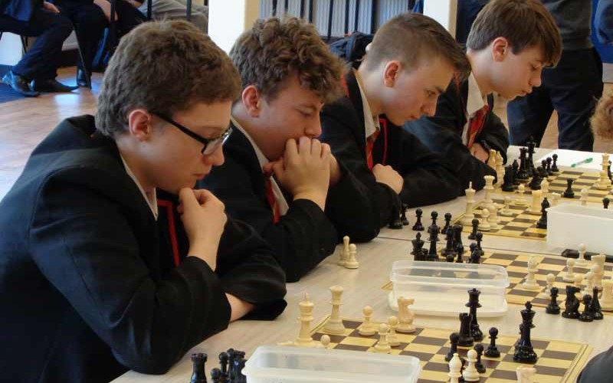
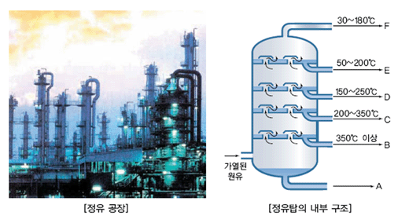
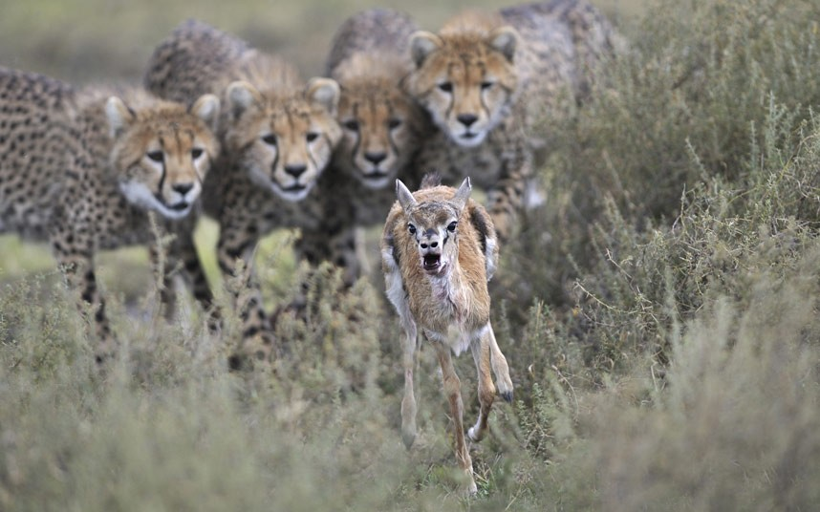

Learning in real-time world
<chess play>
<petroleum refinery control>
<baby gazelle’s running>
<prepare breakfast>

Slide 9
All have something in common
- All involve interaction between each agent and its environment
- Agent’s actions are permitted to affect the future state of the environment
- Agent seeks to achieve a goal despite uncertainty about its environment
- Agent can use its experience to improve its performance over time

Slide 10
3. Elements of Reinforcement Learning

Slide 11
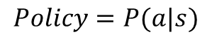
1) Policy
policy
State
Action
$$Policy=P(a|s)$$
- Define the learning agent’s way of behaving at a given time
- Mapping state to action to be taken when in those states
- Core of a reinforcement learning agent
- Policies may be stochastic

Slide 12
2) Reward function
Reward function
State
(+action)
Reward
- Define the goal in a reinforcement learning problem
- Indicate the intrinsic desirability of that state as a single number
- Indicate what is good in an immediate sense
- Maximize the total reward is agent’s sole objective
- Reward function may be stochastic

Slide 13

3)Value function
$$value function v\left(s\right)=\max_{a}{({Reward}_{s}+{Reward}_{s+1}+…+{Reward}_{goal}) }$$
- Specify what is good in the long run.
Total amount of reward an agent can expect to accumulate
over the future, starting from that state.
- Although, a state always yield a low reward but still have a high value
In decision-making and planning, it is most concerned
Because, we seek actions that bring about state of highest value

Slide 14
3-2)Evolutionary methods
- All reinforcement learning methods we consider in this book are structured around estimating value functions
- But value function is not strictly necessary to solve RL problem
Such as genetic algorithms, genetic programming, etc search directly in the space of policies without ever appealing to value function.
We call these evolutionary methods
But, RL involve learning while interacting with the environment,
which evolutionary methods don’t do
For simplicity, we exclude evolutionary method from RL

Slide 15
4)Model
- Something that mimics the behavior of the environment.
- Model are used for planning
Early RL systems were explicitly trial-and-error learner.
Viewed as the opposite of planning
incorporation of models and planning into RL systems
is a relatively new development.

Slide 16
4. An Extended Example
: Tic-Tac-Toe

Slide 17
Tic-Tac-Toe is ...
Assume that
-We are playing against an imperfect player.
-Draws and losses to be equally bad for us.

Slide 18
How do we construct a learning agent?
A classical solutions
Dynamic Programming
Minimax

Slide 19
How do we construct a learning agent?
A classical solutions
Dynamic Programming
Minimax

Slide 20
How do we construct a learning agent?
An evolutionary approach
Hill of policy space
Basis of scalar evaluations
Apply hundreds of different policy

Slide 21
How do we construct a learning agent?
An reinforcement learning method
Probability of win from this state = value
0.4

Slide 22
How do we construct a learning agent?
An reinforcement learning method
0.4
 | 0.5
better

Slide 23
How do we construct a learning agent?
An reinforcement learning method
Initialize all to 0.5
0.5 | 0.5 | 0.5
0.5 | 0.5 | 0.5
0.5 | 0.5 | 0.5

Slide 24
How do we construct a learning agent?
An reinforcement learning method
After play many games against the opponent
0.2 | 0.8 | 0.6
0.3 | 0.5 | 0.1
0.2 | 0.05 | 0.3

Slide 25
How do we construct a learning agent?
An reinforcement learning method
Most of the time we move greedily
0.2 | 0.8 | 0.6
0.3 | 0.5 | 0.1
0.2 | 0.05 | 0.3

Slide 26
How do we construct a learning agent?
An reinforcement learning method
Occasionally, we move randomly
0.2 | 0.8 | 0.6
0.3 | 0.5 | 0.1
0.2 | 0.05 | 0.3
Exploratory move
= cause us to experience state

Slide 27
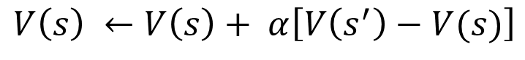
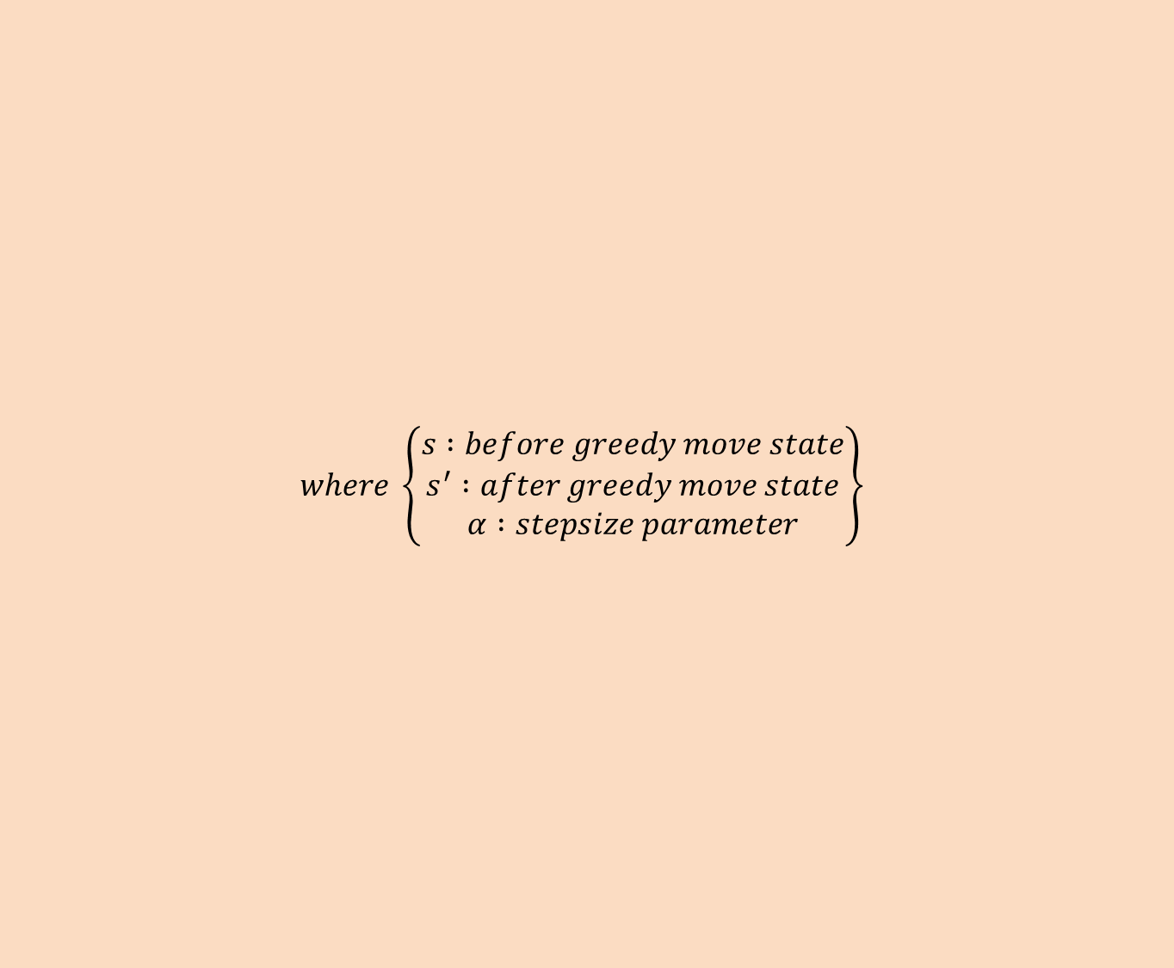

$$where \left\{\begin{aligned}\begin{aligned}s :before greedy move state \\ s^{′} :after greedy move state\end{aligned} \\ α :stepsize parameter\end{aligned}\right\}$$
How do we construct a learning agent?
Mean of exploratory move
Back up
$$V\left(s\right) ←V\left(s\right)+ α\left[V\left(s^{′}\right)−V(s)\right]$$
Temporal-difference learning
$$if the α is reduced properly over time, this method converges$$

Slide 28
How do we construct a learning agent?
Evolutionary method VS value function
Only the final outcome of each game is used
Allow individual states to be evaluated

Slide 29
Limitless of RL
- Applicable when behavior continues indefinitely
- Applicable when rewards of various magnitudes can be received
at any time
- Applicable when state set is very large, or even infinite.
- prior information or model of the game are not essential

Slide 30
5. Summary

Slide 31
Summary
- RL is a computational approach to understanding and automating
cgoal-directed learning and decision-making.
- RL use a formal framework defining the interaction between a learning agent and its environment in term of states, actions, and rewards
- Value and value functions are the key features of the reinforcement learning methods

Slide 32
6. Histrory of Reinforcement Learning

Slide 33
Two main thread
[첫번째 thread]
동물 심리학으로 부터 나온 시행착오(trial and error)를 통한 학습
[두번째 thread]
Dynamic programming과 value function을 사용한 Optimal control 의 solution을 구하는 문제

Slide 34
Two main thread
trial and error
trial and error + Optimal control
Optimal control
1980s

Slide 35
Optimal control
Optimal control 등장
Policy iteration 등장
1950s
1960s
Richard Bellman – Bellman equation
– Dynamic programming
– MDP
Ron Howard – policy iteration method for MDPs

Slide 36
Optimal control
1950s 부터 Dynamic programming는 엄청나게 발전했다.
1980s
1960s
White – Many applications
ETC..
Lovejoy – extensions to partially observable MDPs
Rust – approximation methods
ETC…

Slide 37
Optimal control
1980s
1990s
White – Many applications
ETC..
Lovejoy – extensions to partially observable MDPs
Rust – approximation methods
ETC…
Dynamic programming같은 optimal control problem들은
강화학습과 밀접한 연관이 있다. (특히 MDP에서)

Slide 38
Trial and Error learning
같은 상황이라도 받는 효과에 따라 동물들의 선호도가 달라졌다.
1910s
Thorndike – Law of Effect
selectional
여러 방법들을 찾고 비교 한 후 선택
하는 것
ex) 자연적 선택에 의한 진화
associative
선택 되어진 대안들은
특정한 상황들과 연관이 있다는 것
ex) supervised learning
Search
많은 action들 중 무엇을 선택할지 결정하는 것
Memory
가장 좋았던 action들을 기억하는 것

Slide 39
Trial and Error learning
AI가 engineering의 일부였던 초기 시절.
Trial and error learning에 대한 연구가 시작 되었다.
1950s
1960s
Minsky and Farley and Clark
- trial and error 학습에 대해 최초로 컴퓨터 관련
조사를 한 사람들
Minsky – Steps toward Artificial Intelligence
Supervised Learning 과 Reinforcement Learning의
구분이 재대로 되어 있지 않던 시절.

Slide 40
Trial and Error learning
이러한 혼란의 영향으로 진짜 trial-and-error 학습은 거의 없던 시절.
환경과 상호 작용하는 Trial and error learning method 발명
1960s
1970s
Andreae – STeLLA
Donald Michie – 간단한 시행착오 학습 체계: MENACE
Michie and Chambers – tic-tac-toe 게임 학습 엔진:GLEE
– reinforcement learning controller: BOXES
Minsky – Steps toward Artificial Intelligence

Slide 41
Combine
Supervised learning과 reinforcement learning의
큰 차이를 밝혀냄
3번째 Thread로써
Temporal-difference learning 사용
1980s
1989
3가지 thread를 모두 합친
Q-learning 등장

Slide 42
THANK YOU
PRESENTATION

